Slide 1

Covid Vs Mathematics
Mathematical analysis on Covid-19
Presented by kokila & Ananth
B-Tech -2nd Year- CSBS
BIT , Sathy

Slide 2

Table of Contents
01
02
Objectives
Methodology
03
04
Results Analysis
Conclusions

Slide 3
Introduction
Genome Analysis
01
Behaviour is therefore unpredictable in the short term, but broadly predictable in the long term.
Symptom Analysis
02
Sometimes analysis provides different solutions.
Lock down Needed:
03
Lockdown is meant to prevent the spread of infection from one person to another, to protect ourselves and others.
Economic crisis due to lockdown:
04
Economy is the very important thing in this world. Around 12 million people lost their lives due to coronavirus.

Slide 4

Introduction
Genome Sequence Analysis of Covid
We try to analysed COVID, SARS, and MERS genome. Try to found the relationship between the above-mentioned viruses along with the visualization of those things.

Slide 5
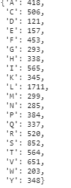
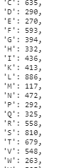
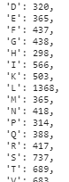
Study Objectives
MERS
SARS
COVID
Middle East respiratory syndrome-related coronavirus, or EMC/2012, is a species of coronavirus which infects humans, bats, and camels.
Severe acute respiratory syndrome (SARS) is a viral respiratory disease caused by a SARS-associated coronavirus. It was first identified at the end of February
Novel Coronavirus Disease (COVID-19) outbreak as a pandemic and reiterated the call for countries to take immediate actions

Slide 6
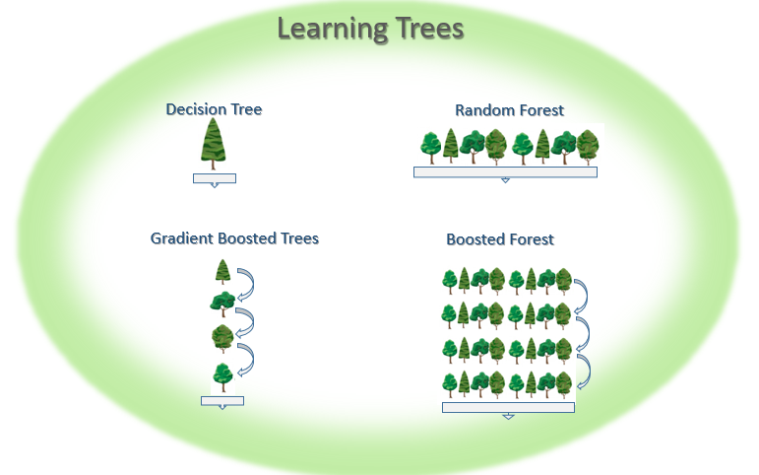
Boosted Random Algorithm
Each node of branches of presenting each base (AGTC and symptoms like fever, diarrheic, nostril infection, tiredness, etc

Slide 7
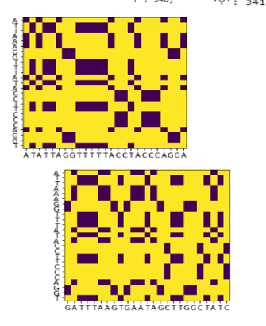
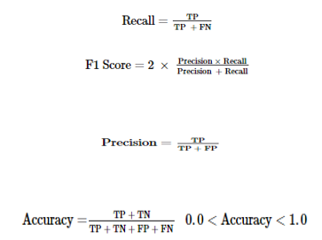
Comparing the genome

Slide 8

Introduction
Symptom Analysis
?

Slide 9
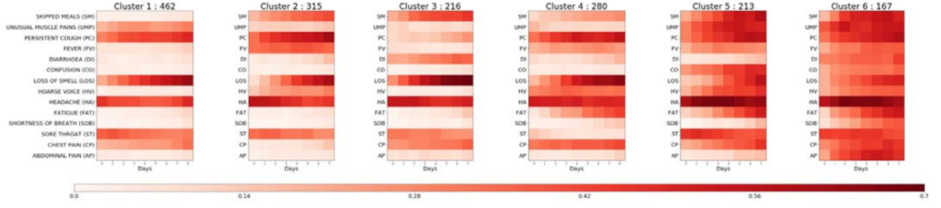
Six types of Covid-19

Slide 10
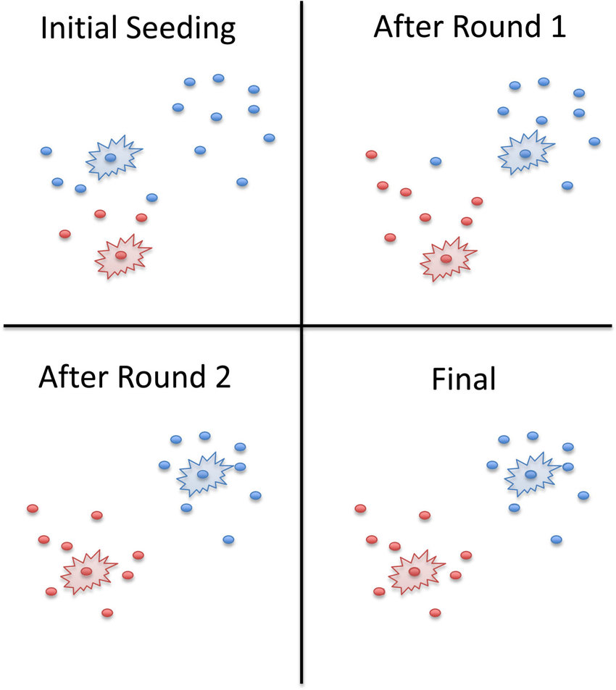
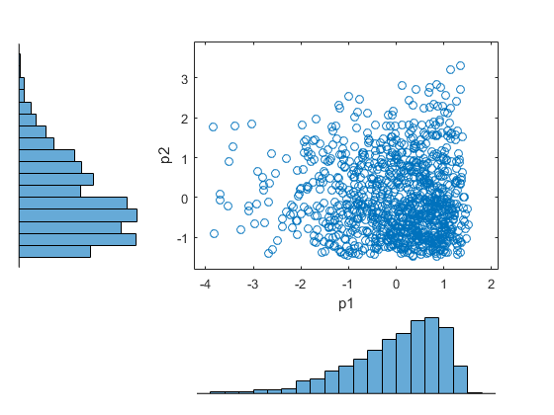
Risk/ratio guide for re-opening of the economies out of lockdown
Algorithm Proposed
Correlation and Clustering

Slide 11

Introduction
ECONOMIC CRISIS
6,740,000/12,300,000 = a proportion of 0.55
Risk/ratio guide for re-opening of the economies out of lockdown

Slide 12

Introduction
Lockdown Needed
Because I could not challenge lockdown;
It did kindly challenge me.
Does the lockdown make you shiver?
Does it?

Slide 13
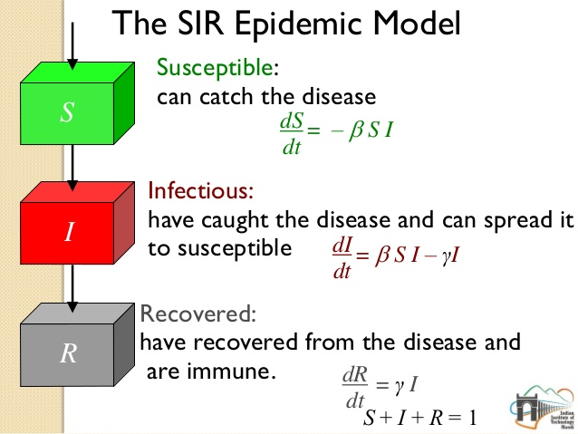
SIR Model
The only model which are followed by all mathematicians to analyse on the need of lockdown due to COVID-19.

Slide 14
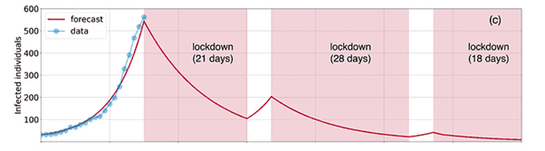

Graphical Analysis On lock down
The 21-day lockdown just causes us purchase time to set ourselves up for better battle against Coronavirus.

Slide 15
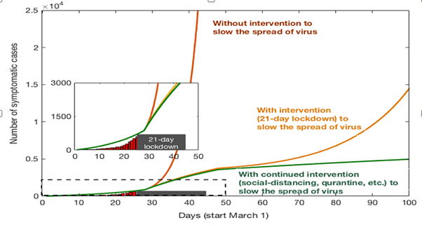

Analysis on COVID-19 cases

Slide 16
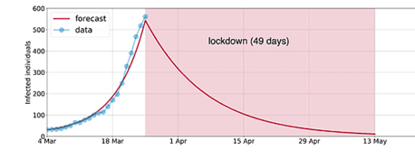
Super Lock Down
If we follow complete lock down, very sure that we will reduce the spread of COVID-19 soon…...

Slide 17

Introduction
Future Prediction and forecasting
We can able to analysis the future
with the help of
ARTIFICIAL INTELLIGENCE

Slide 18
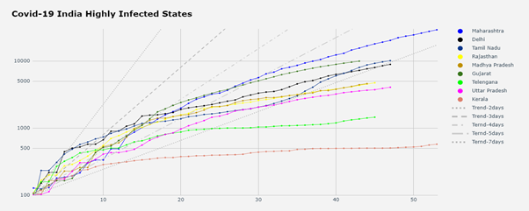
Infected Model
It’s a growing curve and you don’t know where it’s going to finish.

Slide 19
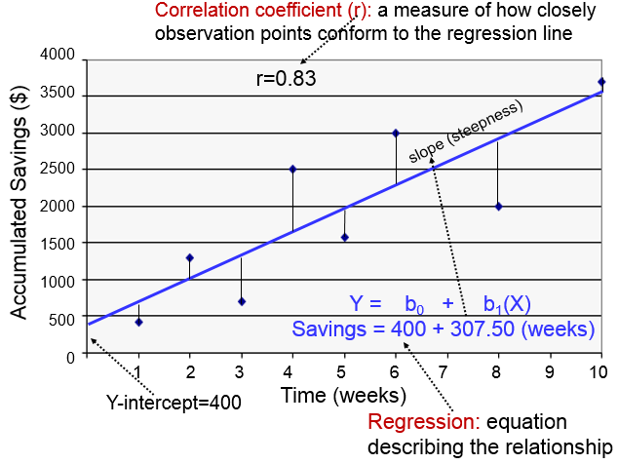
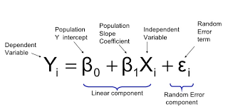
Risk/ratio guide for re-opening of the economies out of lockdown
Algorithm Proposed
Linear Regression

Slide 20
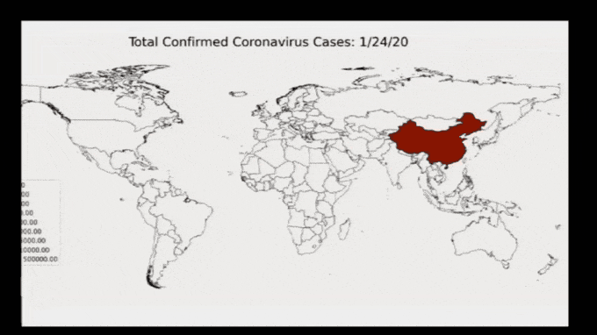
Introduction
Forecasting
We can able to analyse with the help of geopandas and matplotlib

Slide 21



Conclusions
1
2
Stary Home
Be Safe

